Slide 1
Brain MRI Tumor Detection
Google/NACME Applied Machine Learning Intensive Capstone
Julio Sibrian, Alexis Mercado, Gerardo Moreno

Slide 2
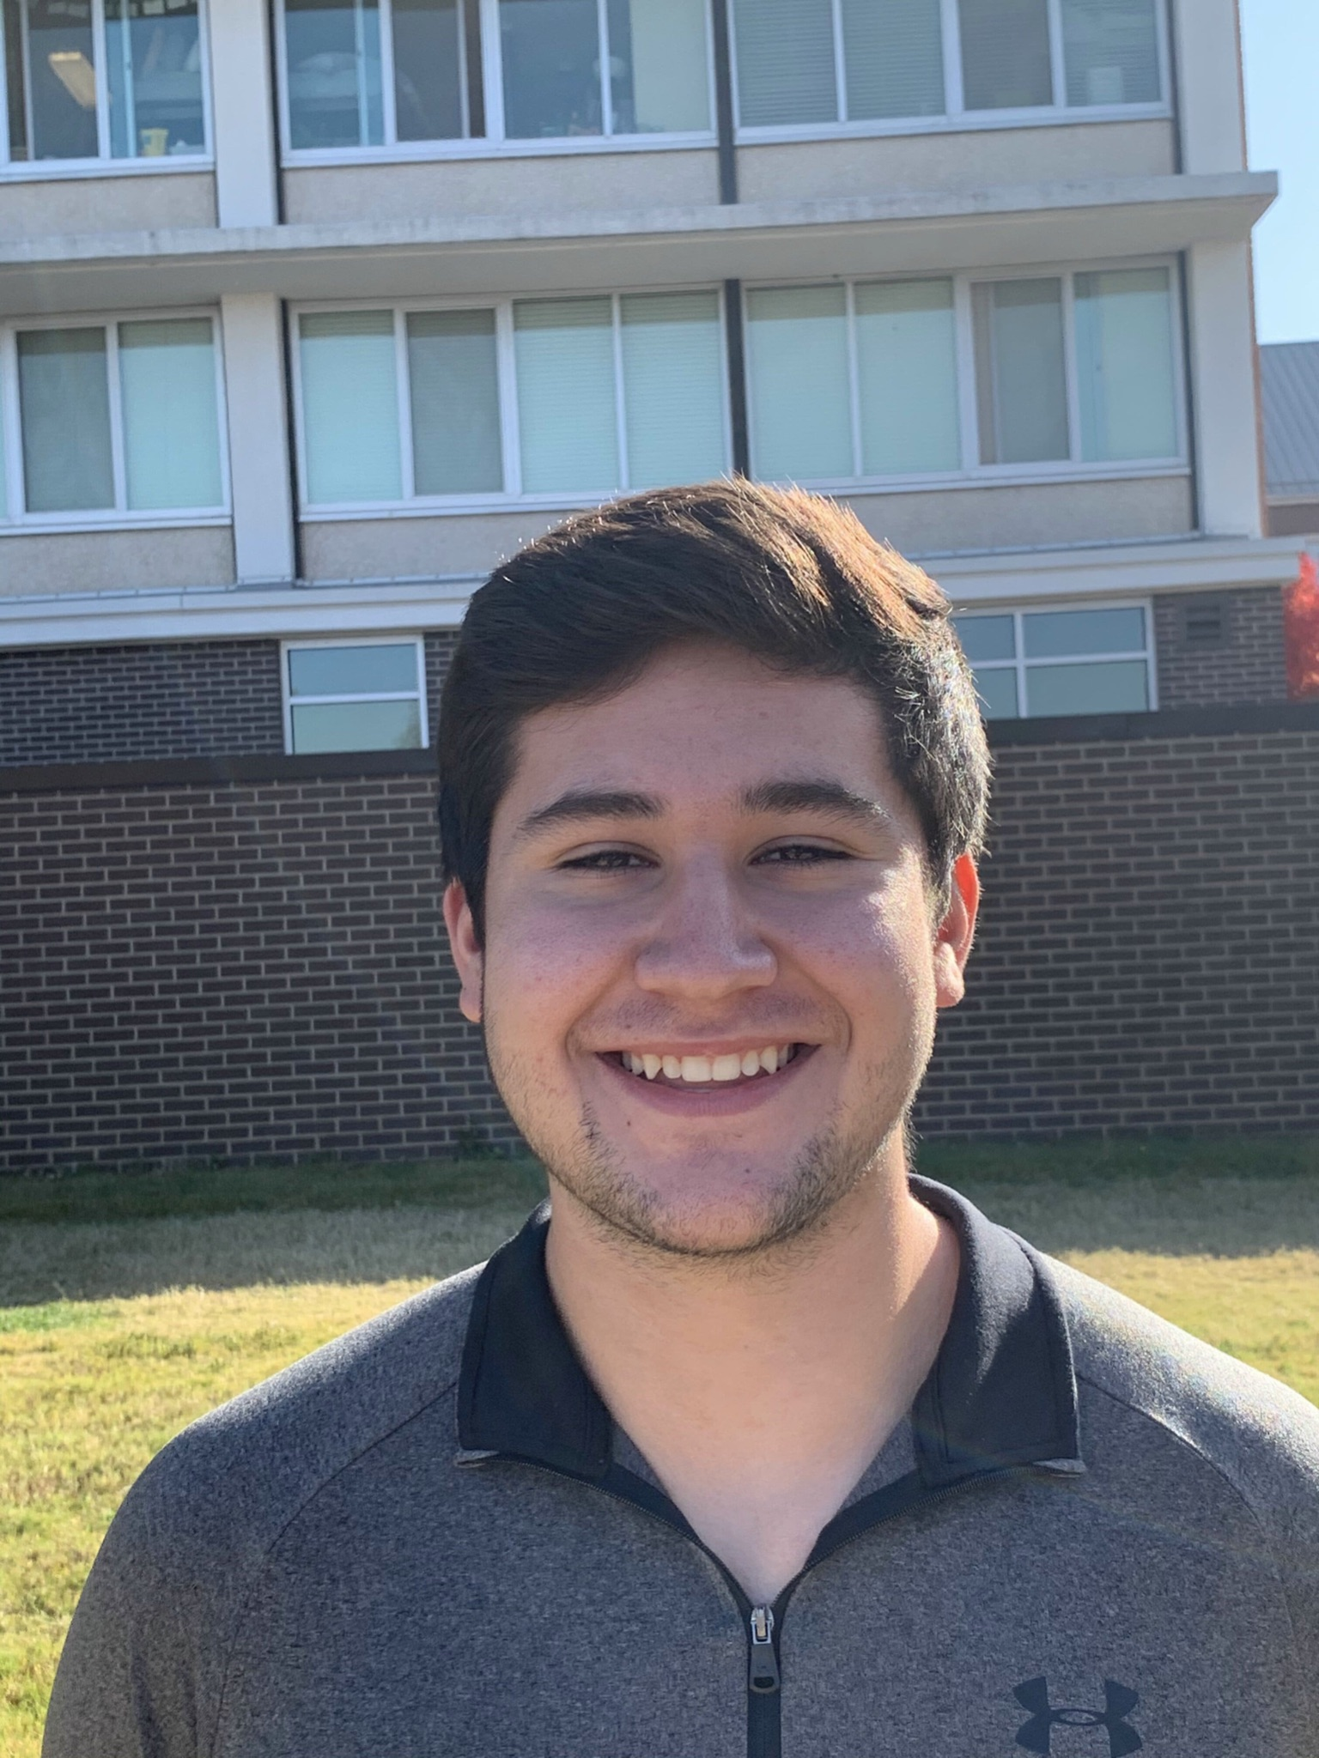
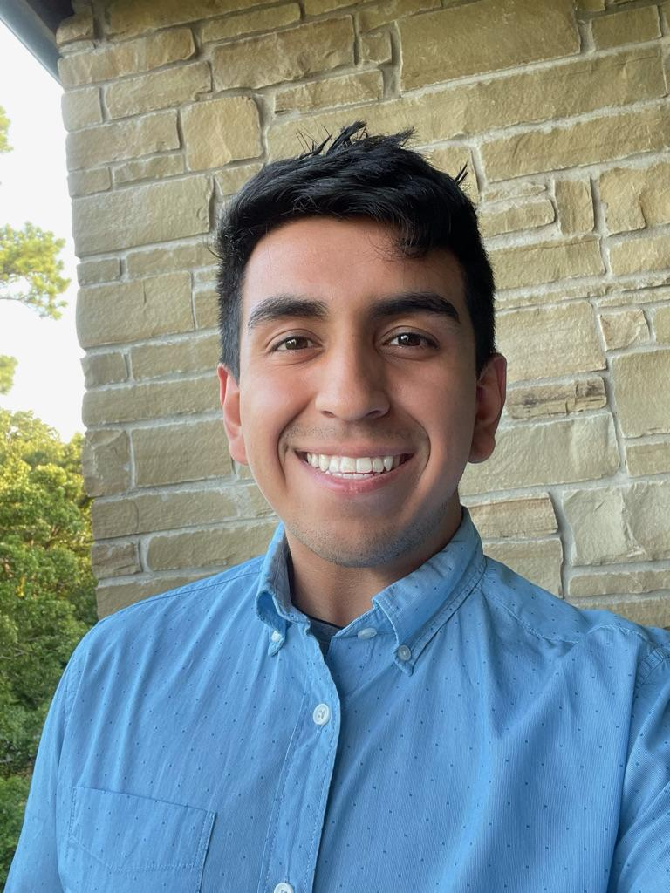
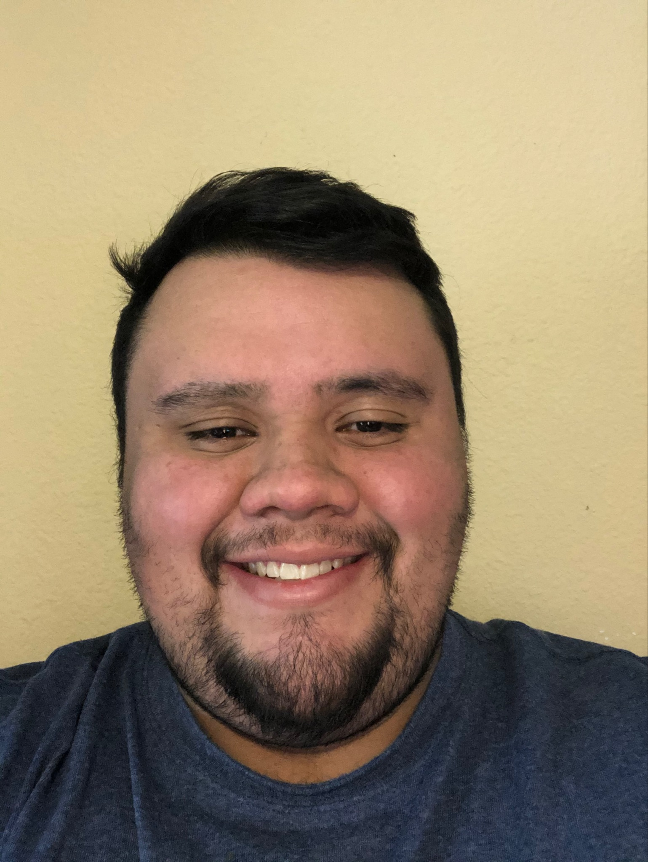
Team Members
Julio Sibrian
University of Arkansas
Computer Science
Gerardo Moreno
University of Arkansas
Data Science
Alexis Mercado
University of Arkansas
Computer Science

Slide 3
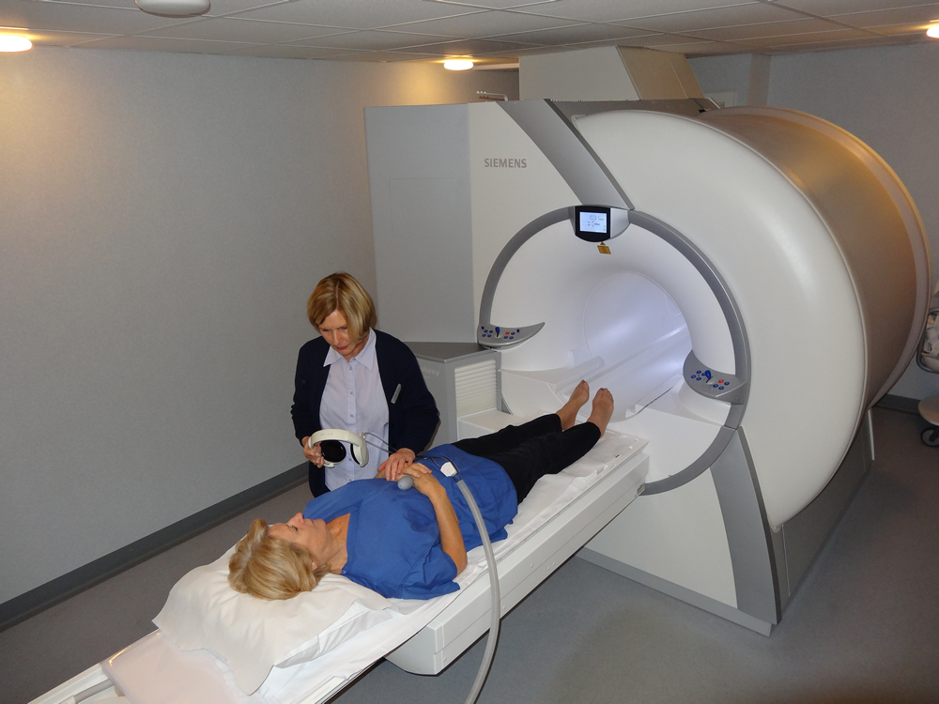
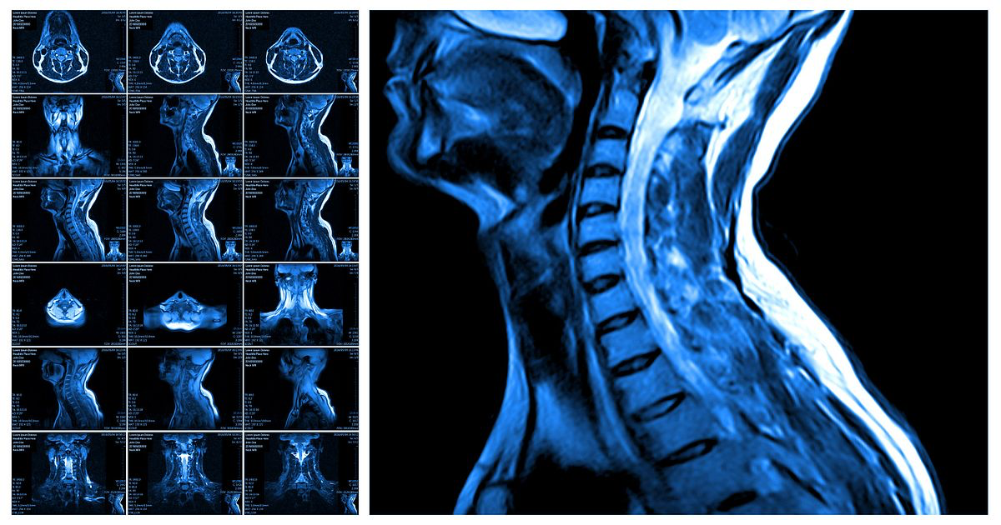
Introduction
There are around 700,000 people currently living with a brain tumor
The survival rate for them is about 75%.
Symptoms : increasingly strong headaches, blurred vision, loss of balance, confusion, and seizures, but may be no symptoms.
Source: National Brain Tumor Society
Notes:
Sometimes these tumors may be difficult to detect because of the fact that symptoms may not be shown. Tumors are a time sensitive issue and every minute counts when detecting a tumor and providing adequate treatment. Most common in children of ages between 0-14, but the average diagnosis age is 59 years old.

Slide 4
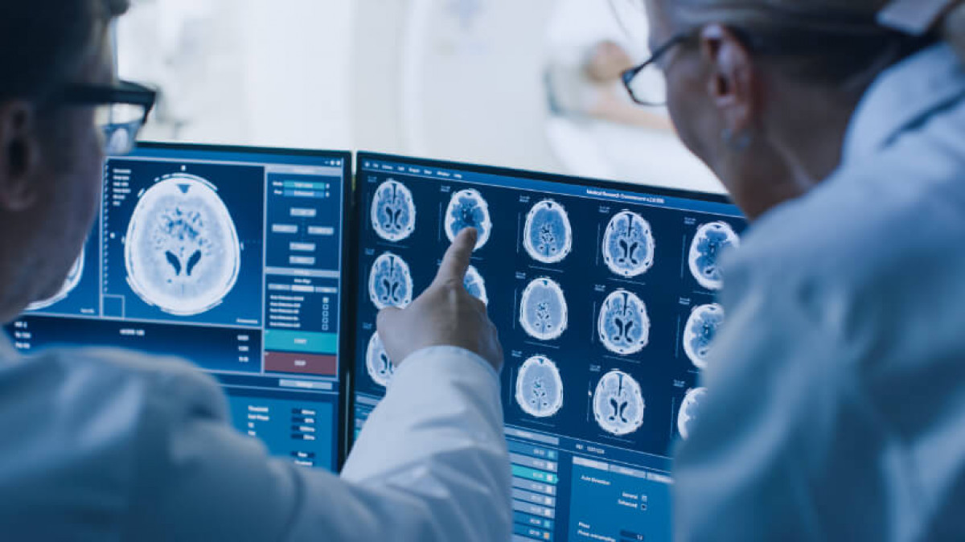
Project Motivation
The goal of this project is to address the issues of tumors and be able to diagnose them through machine learning. The benefits of this project would be the automation of a process that is typically done in person by a professional. We aim to create a program that could potentially speed up the process and even free up the professionals time in order for them to tend to more patients.

Slide 5

Overview
MRI Scans
Convolutional Neural Networks (CNN)
TensorFlow
Keras Library
Model Analysis

Slide 6
Capstone Timeline
Data Visualization
Exploratory Data Analysis
Building CNN Model
Utilizing TensorFlow and Keras
Data Augmentation
Balance Data and Image Enhancements
Model Analysis
Analysis of Final Model

Slide 7
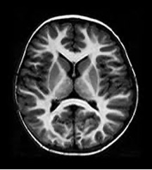
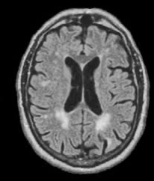
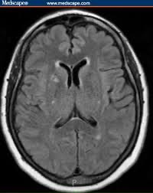
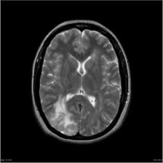
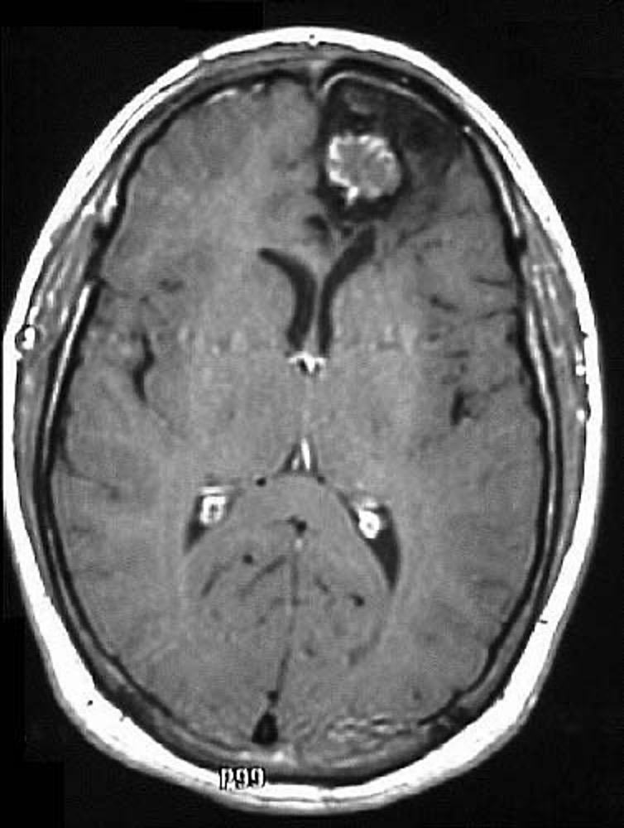
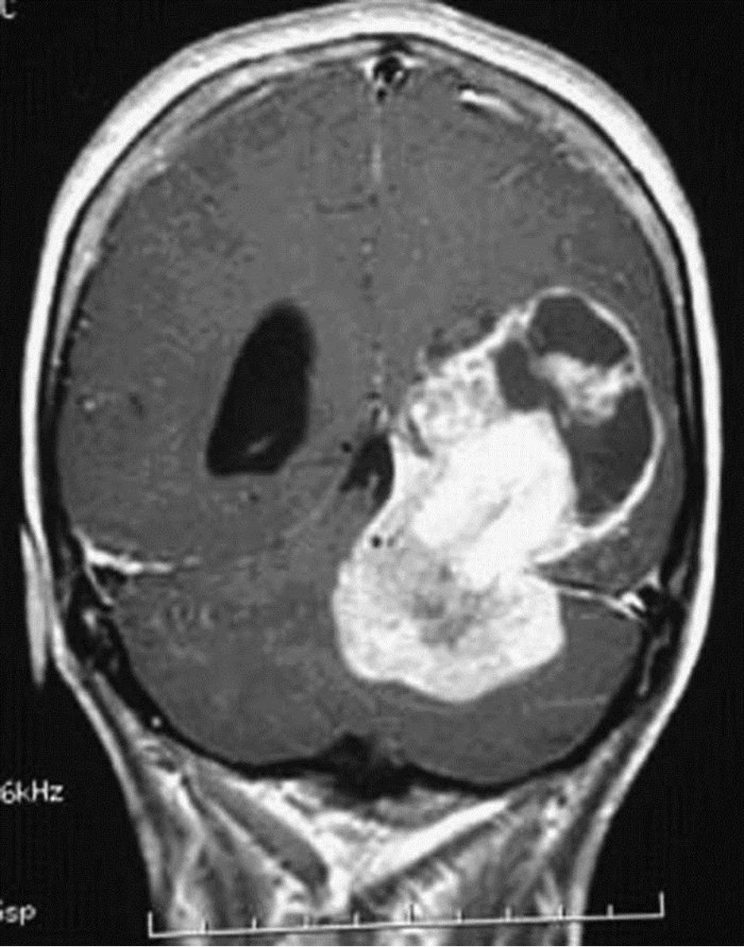
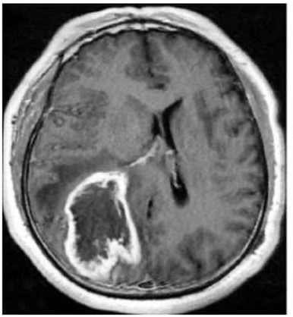
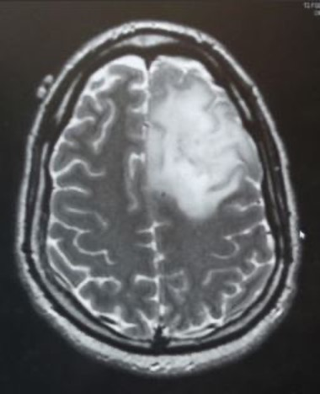
Data Visualization
Tumor MRI’s: 155
Normal MRI’s: 98
MRI’s with
no tumors
MRI’s
with tumors
Dataset: https://www.kaggle.com/navoneel/brain-mri-images-for-brain-tumor-detection

Slide 8
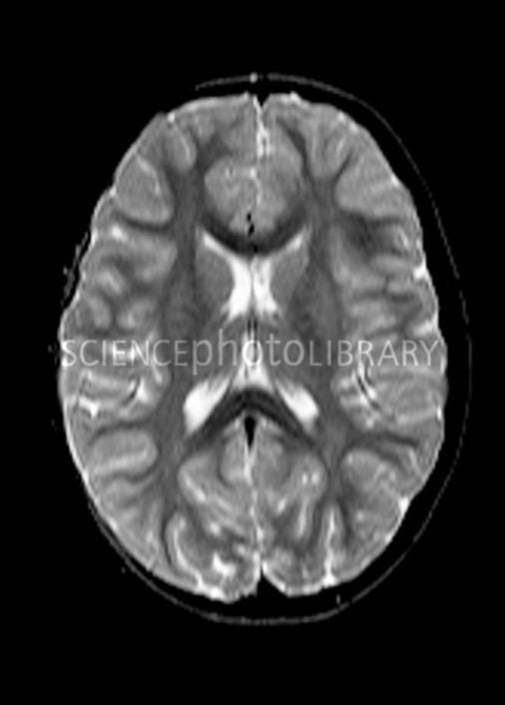
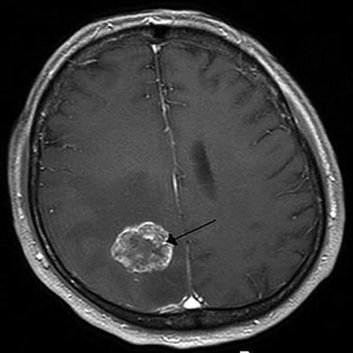
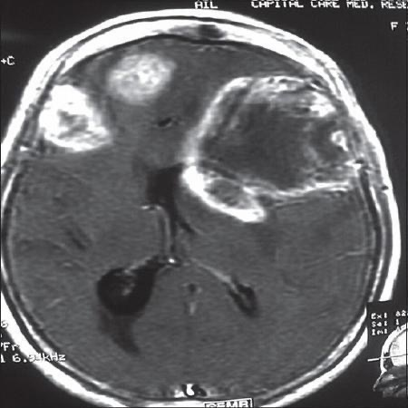
Bad Data

Slide 9
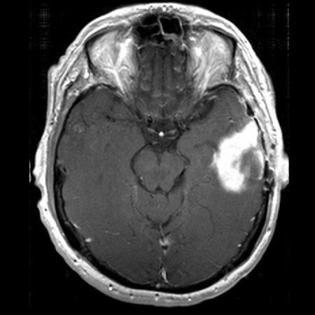
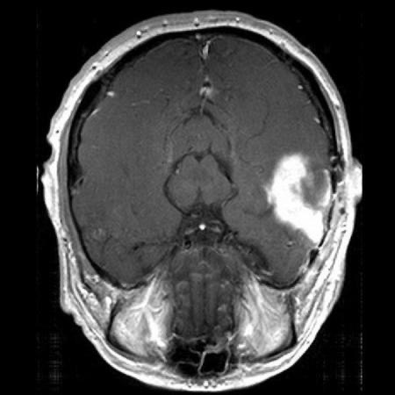
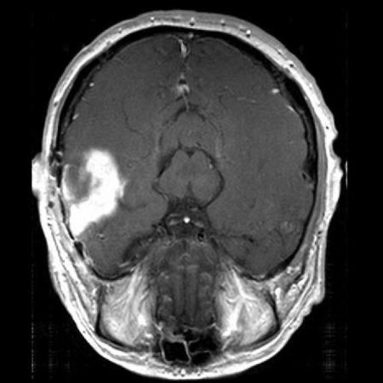
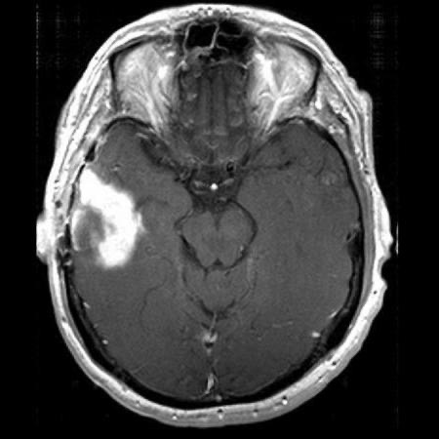
Data Augmentation
Regular
Flipped
Rotate 180
Mirrored

Slide 10
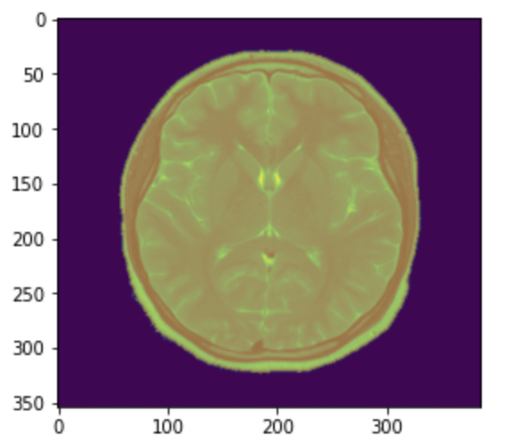
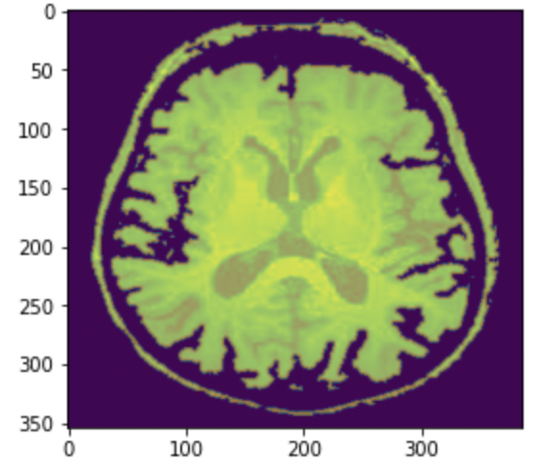
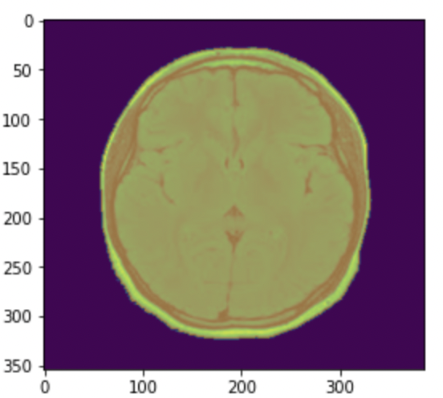
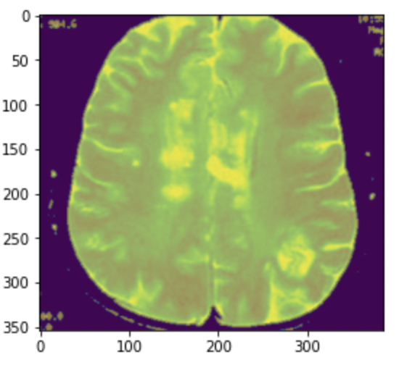
Masking

Slide 11
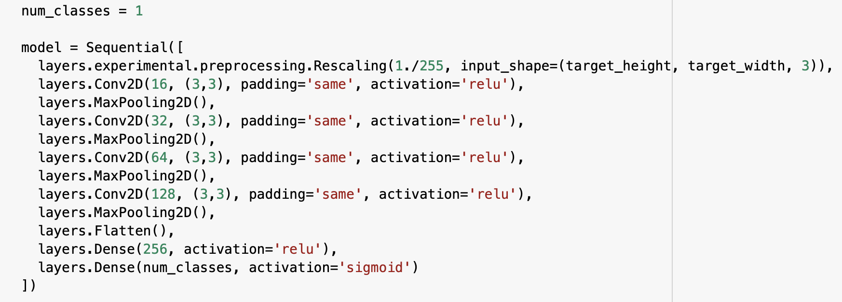
Building our Model
School Name
Anytown, ST
MBA: May 20XX
School Name
Anytown, ST
BS, Computer Science: May 20XX
School Name
Anytown, ST
AdTech Lab: January 20XX

Slide 12
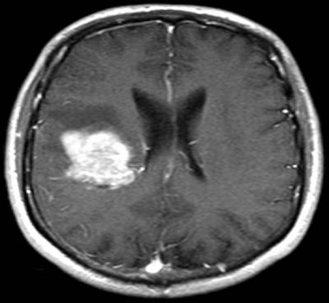
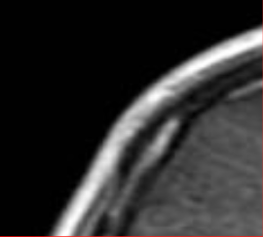
Kernel and Strides

Slide 13
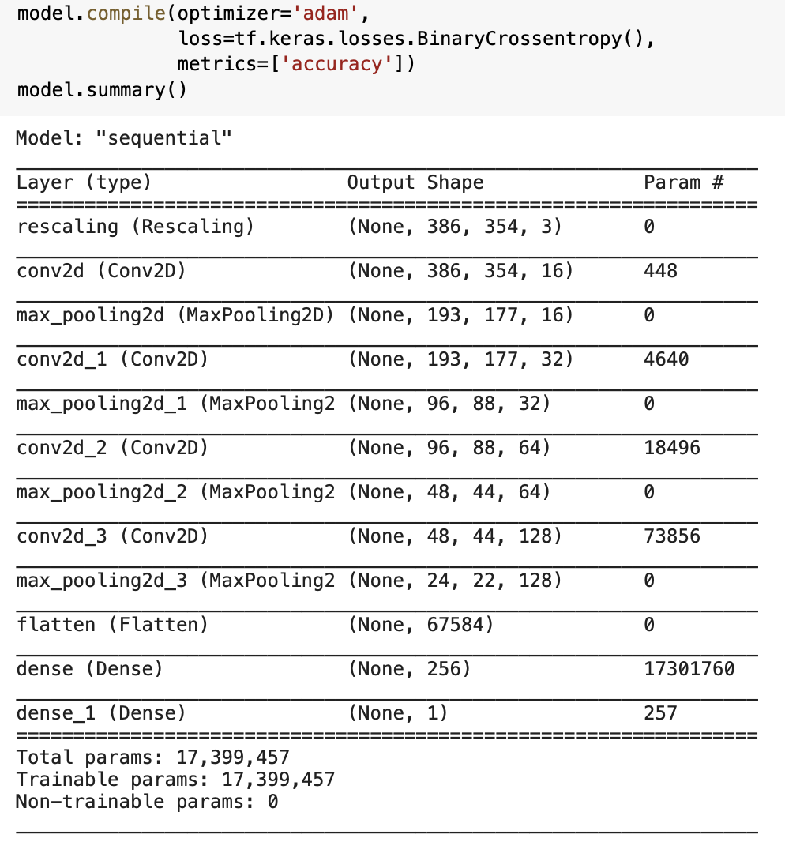
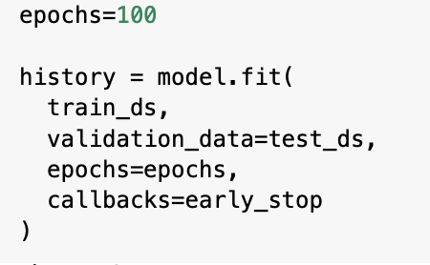
Compiling the Model

Slide 14
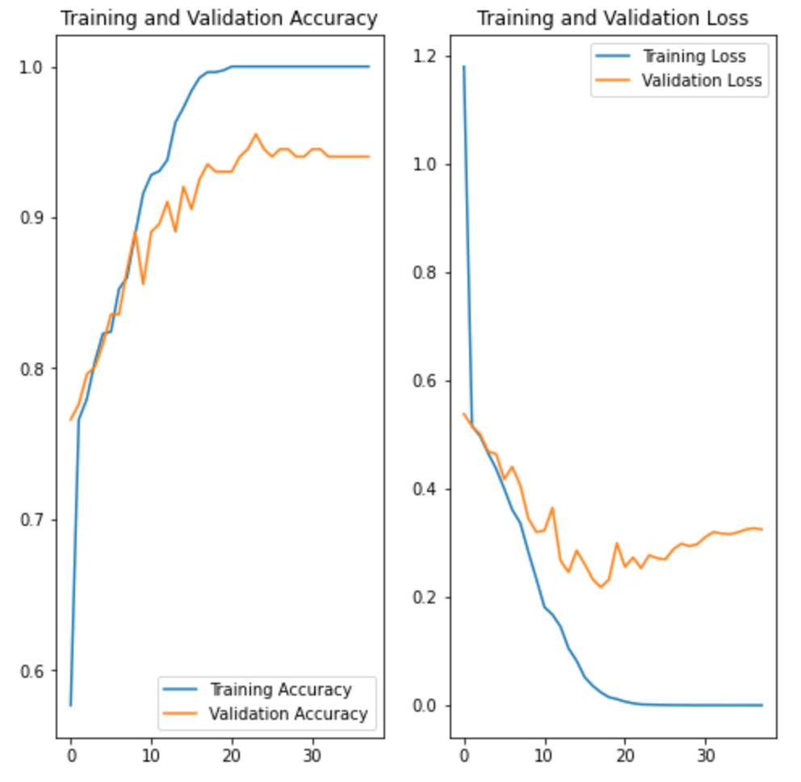
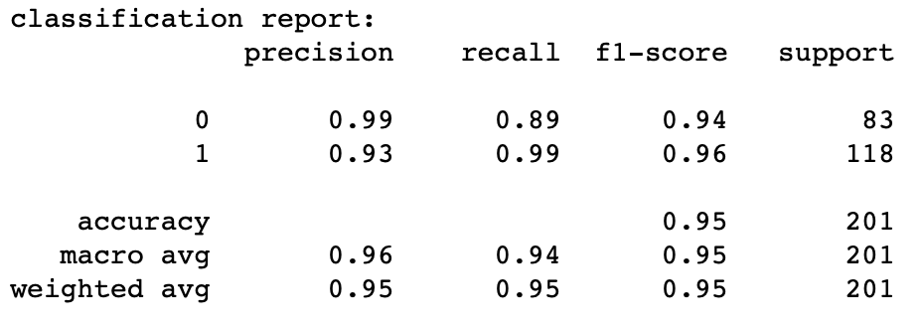
Analyzing Model

Slide 15
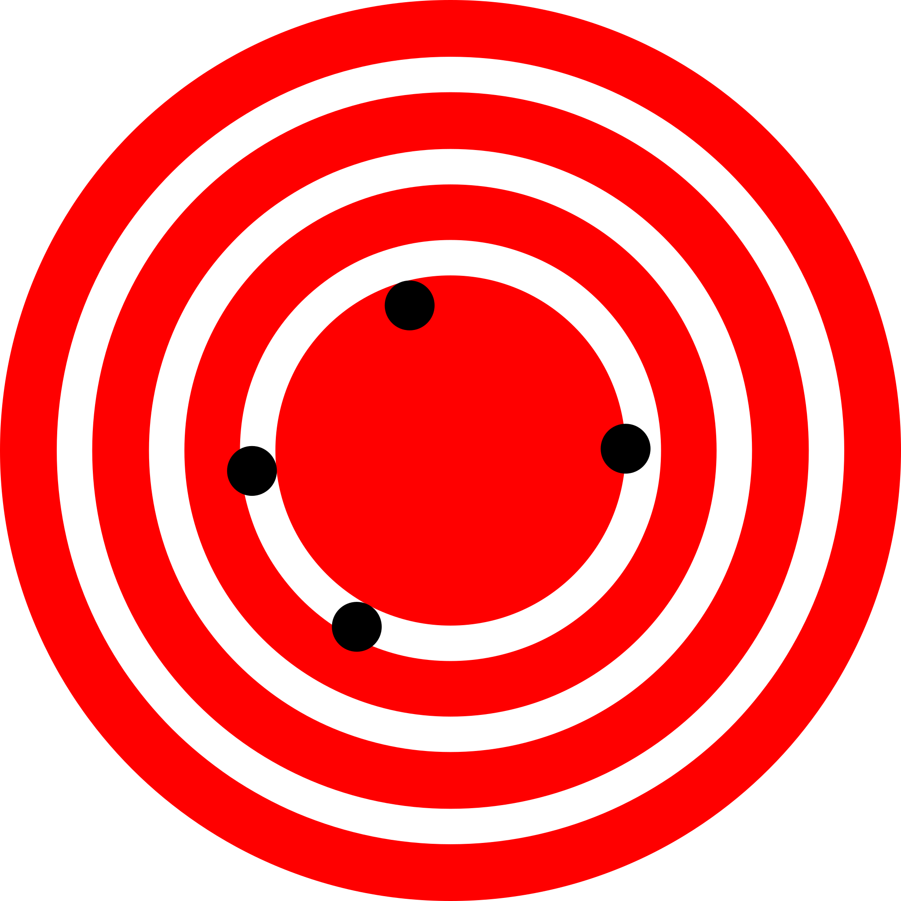
Trial and Errors
Further Data Augmentation (rotation: 90, 270)
Loss Functions (hinge loss, and squared hinge loss)
Optimizers(Adagrad, Adadelta, RMSprop)
Kernel sizes ( (1x1), (2x2), (3x3), (4x4) )
Activation methods (Hidden: sigmoid, elu, tanh; Output: softmax, linear)

Slide 16

Predictions

Slide 17
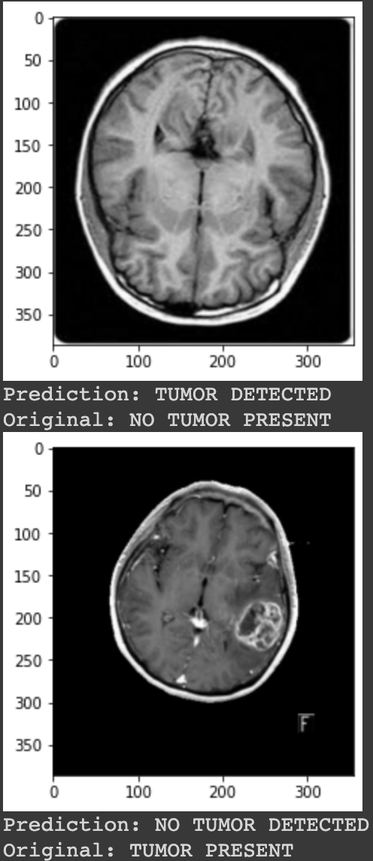
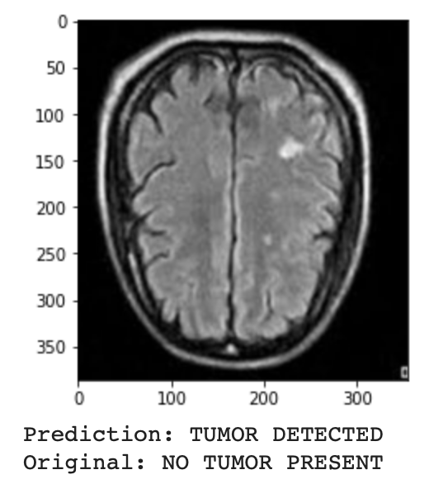
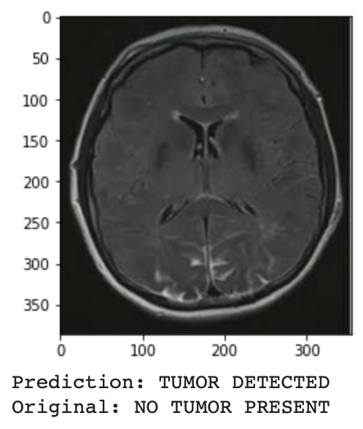
Samples of Misclassification

Slide 18
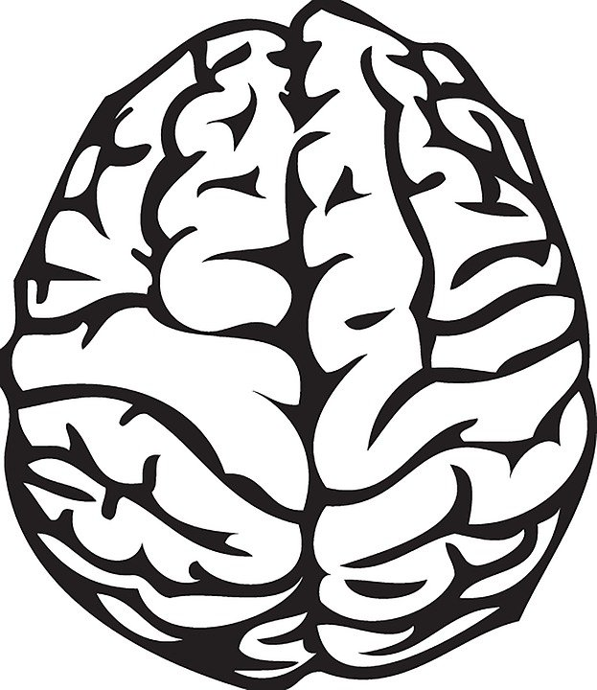
Conclusion
Problems encountered
Images
CNN’s
Final Model
Improvements
Future
Notes:
In conclusion, our group was able to create and train a Convolutional Neural Network
model with a very high accuracy and precision to detect brain tumors. Our model could
assist medical staff quickly detect and recognize brain tumors in MRI scans, which exactly
aligns with our group’s mission of helping medical patients and healthcare professionals
using machine learning. The importance our model brings to the problem of brain tumor
detection would be to make the process of reviewing MRI scans more efficient and attempt
to accelerate the process of detecting brain tumors using a machine learning model. As
medical staff and patients receive quicker results from our model, further necessary actions
can be determined for the patient, as tumors could be time sensitive.
Potential further improvements our model could implement is outlining the brain tumor,
proper image processing, and acquiring adequate data of MRI scans. Applying a red box
outlining the brain tumor in the MRI scan would be the first improvement our group would
have been specified more time. Building this into our model could help medical professionals
precisely determine where the brain tumor or supposed tumor is located in the MRI scan.
Another way our group could improve this model would be to properly pre-process all
the images in our data set. From the MRI scans our model misclassified had an overall
similarities were the different background colors of the images. Given more time, our group
could have done a better job masking and cutting the images to only focus on the brain,
leaving no background that could possibly interfere with detecting a pattern in our model.
The data set we utilized in this project only consisted of 253 images, which is not the ideal
number of data to build and train a machine learning model. If our group could prepare
for this project next time, we would apply to gain access to MRI scans straight from the
sources to properly build and train our model to be optimized. Overall our project was
successful, with these simple improvements with more time could have taken our project to
the next level.

